Slide 1
Heteroskedasticity
Part 2
BUAN / MECO 6312
Dr. Moran Blueshtein
University of Texas - Dallas

Slide 2
Consequences for the Least Squares Estimators
Recall that there are two problems with using the least squares estimator in the presence of heteroskedasticity:
The least squares estimator, although still being unbiased and consistent, is no longer best
The usual least squares’ standard errors are incorrect, which invalidates confidence intervals and hypothesis tests

Slide 3
Heteroskedasticity-Robust Standard Errors

Slide 4
Heteroskedasticity-Consistent Standard Errors
There are two problems with using the least squares estimator in the presence of heteroskedasticity:
The least squares estimator, although still being unbiased and consistent, is no longer best
We can tolerate this. We will keep using the least squares estimator.
The usual least squares’ standard errors are incorrect, which invalidates confidence intervals and hypothesis tests.
There is a way of correcting the standard errors so that our confidence interval and hypothesis tests are valid.

Slide 5
Heteroskedasticity-Consistent Standard Errors

Slide 6
Heteroskedasticity-Consistent Standard Errors
Under heteroskedasticity:

Slide 7
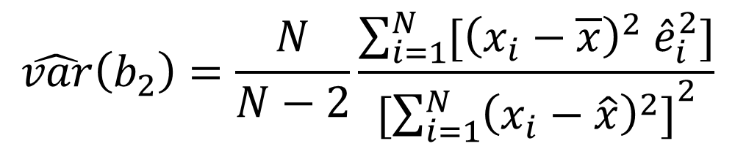
Heteroskedasticity-Consistent Standard Errors
An unbiased estimator is :
$$\hat{var}\left(b_{2}\right)=\frac{N}{N−2}\frac{\sum_{i=1}^{N}{[{\left(x_{i}−\overline{x}\right)}^{2} {\hat{e}}_{i}^{2}]}}{[{\sum_{i=1}^{N}{{\left(x_{i}−\hat{x}\right)}^{2}]}}^{2}}$$

Slide 8
Heteroskedasticity-Consistent Standard Errors
These standard errors are known as:
White’s heteroskedasticity-consistent standard errors, or
Heteroskedasticity robust standard errors, or
Robust standard errors.

Slide 9
Heteroskedasticity-Consistent Standard Errors
With White’s robust standard errors, standard errors are correct. However the estimator is still not best.
With a large enough sample size, this is not a problem - variance of the least squares estimator may still be sufficiently small to get precise estimates
Using least squares with robust standard errors has one big advantage - it avoids the need to specify a suitable variance function
To find an alternative estimator with a lower variance it is necessary to specify a suitable variance function.

Slide 10
Weighted Least Squares

Slide 11
Weighted Least Squares : Known Form of Variance
We can develop an estimator that is more efficient than the least squares estimator if we know the form of the variance σ²_{i} .
For example:
we can give each observation a different weight higher weight to observations with smaller variance. This is the weighted least squares/ generalized least squares estimator.

Slide 12
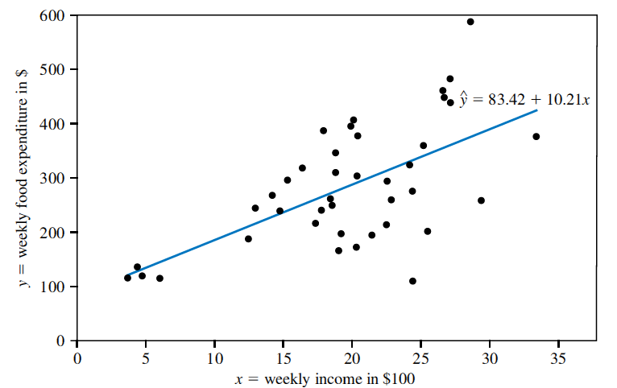
Weighted Least Squares : Known Form of Variance
Least squares estimated food expenditure function and observed data points
As the size of the economic unit becomes larger, there is more uncertainty associated with the outcomes y. These observations are less informative, and should get a lower weight.

Slide 13
Weighted Least Squares : Known Form of Variance
Minimizing the sum of squared transformed errors:
The errors are weighted by

Slide 14
Weighted Least Squares : Known Form of Variance
Weighted Least Squares estimator is more efficient than the least squares estimator if we know the form of the variance
However if our assumption regarding the form of the variance is incorrect, then not only will the estimator be inefficient - the SE will also be incorrect!

